Slide 1
Research Project Workshop 05:
Efficient Searches, Part II
May 3, 2017
Andrew Hamilton, MS, MLS
Laura Zeigen, MA, MLIS, MPH
& Letisha Wyatt, PhD
Instructor(s):

Slide 2
learning outcomes
1 Recall: How to frame your question (define
concepts and keywords) and the
benefits/application of controlled vocabulary
2 Understand and apply unique features of
Ovid Medline database interface (“adjacency”
searching)
3 Understand and apply the unique features of
Scopus database searching
(journal publishing information; author and
institution searching)

Slide 3


comprehensive searches
specificity
sensitivity
Notes:
WHEN AM I DONE??
we want comprehension but not at the sake of thousands of articles to search through

Slide 4
5 A’s method of searching
Assess
Apply
Ask
Appraise
Acquire
Copyright © Centre for Health Evidence

Slide 5
next steps
Building a search (keywords vs. MeSH)
Evaluate your results!
Search details box
MeSH terms on good articles
Revise as needed and try again
Saving your fish: references doc for citation management software
Saving your net: PubMed MyNCBI to save and automate search
Notes:
Build = one term at a time

Slide 6
asking/refining your question
Concept mapping
PICO
These help:
Define broad topical concepts
Describe relationships between concepts
Organize ideas
Develop keywords
Notes:
Difference between background and foreground question
Concept maps = good for developing background (more mechanistic) questions
PICO = good for developing more clinical (applied) questions **don’t start with a question and pull out pieces for PICO!

Slide 7
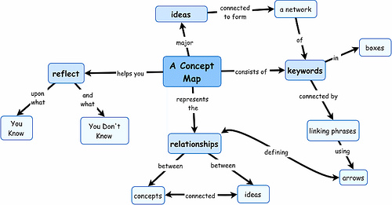
overview of concept maps
Image from here
Notes:
Try making a concept map!
Letisha’s demo
valentine’s day candy example

Slide 8
overview of PICO
P = Population or patient
I = Intervention or exposure
C = Comparison*
O = Outcome
T = Time factors*
S = Setting*
*may not always have this piece

Slide 9
PubMed MeSH terms
Medical Subject Headings:
terms tagged to an article when being indexing in PubMed
Controlled vocabulary!
Updated annually
MeSH terms database – essentially a thesaurus
Tree structure
Hierarchies and exploding
Subheadings

Slide 10
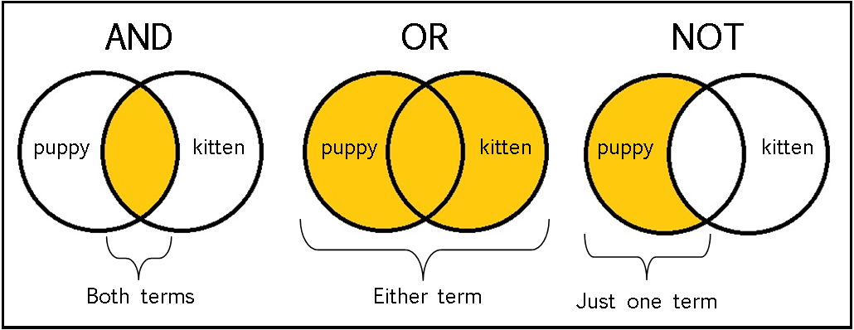
boolean operators
Adapted from https://sites.google.com/a/onalaskaschools.com/tech/boolean-search-tools
Notes:
Provided example: HIV and AIDS; HIV or AIDS

Slide 11
scopus!

Slide 12
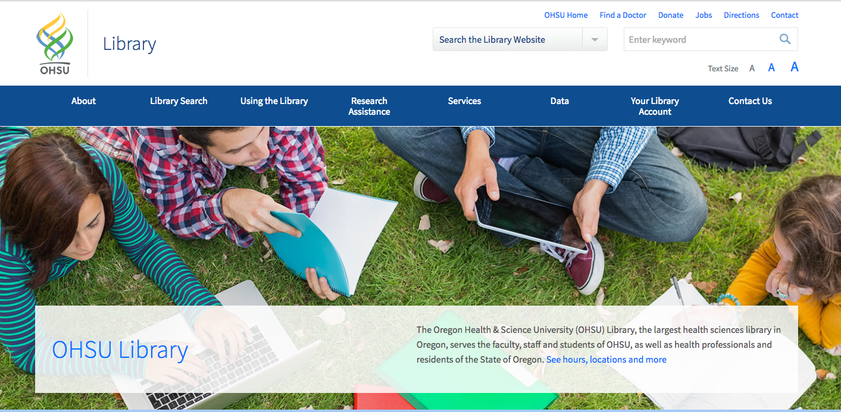
let’s practice together
OHSU Library Webpage
Notes:
Provided example: car accidents and text messaging
Then they use their research question (goal is to acquire some articles or citation files -> we’ll add to citation manager at upcoming session)

Slide 13
recap
1 How to frame your question (define concept
and keywords)
2 Understand the benefit and application of
controlled vocabulary and indexing
3 Execute and save search results or search
strategy

Slide 14
key resources
Ovid Tutorials
Branching Out: The MeSH Vocabulary (11 min video)
Contact us

Slide 15
questions?
Andrew Hamilton, MS, MLS
hamiltoa@ohsu.edu
503.494.7527
Laura Zeigen, MA, MLIS, MPH
zeigenl@ohsu.edu
503.494.0505
Letisha R. Wyatt, PhD
wyattl@ohsu.edu
503.494.8627

